Slide 1


General Introduction to the train the trainers Course
INTERNATIONAL AGENCY FOR RESEARCH ON CANCER LYON - FRANCE
e-SMP
Notes:
Info for the trainers: all comments for the trainers (that should be deleted or adapted for the local training course) are written in pink!!! See for example hh-mm in slide 4

Slide 2

Introduction
Training agenda
Training objectives
Endpoints
GloboDiet training: General Introduction
IARC, Lyon - France

Slide 3


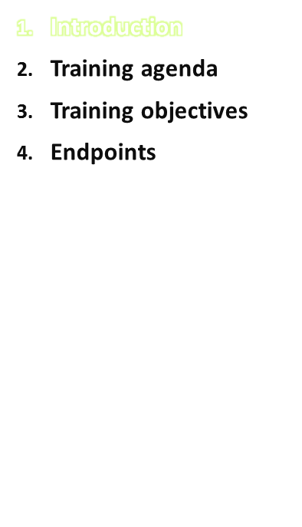
GloboDiet “train the trainer” course:
To train the people in charge of training the local field interviewers (and those who will perform data handling)
Is organised and conducted by IARC, with a focus on the study needs (e.g. national food consumption survey)
Can be performed at IARC and/or via e-training
IARC provides all the necessary training materials to use the GloboDiet methodology for dietary data collection, management and export of dietary interview data
The use of additional tools and facilities will be made available through the e-SMP
Partners will receive instructions and procedures to translate the reference guidelines and to include local examples, still ensuring standardization between countries
IARC, Lyon - France
GloboDiet training: General Introduction

Slide 4
Introduction
e-Training participants will be able to comment and ask questions during the discussion sections via their micro- & headphones or via the chat function
e-Training participants are welcome to give feedback about the training & the GoToWebinar application at any time via email (Huybrechtsi@iarc.fr)
However, for urgent matters the chat or questions function is preferred
GloboDiet training: General Introduction
IARC, Lyon - France

Slide 5
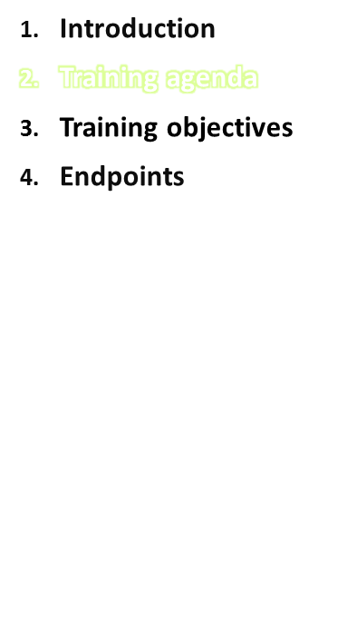
3 day training (at least 3 days)
Lunch break between hh-mm
Training contents:
  Day 1: introduction, concepts & definitions, interview examples, main focus on handling foods
  Day 2: Main focus on handling recipes
  Day 3: e-SMP (interview manager) and evaluation discussion
GloboDiet training: General Introduction
IARC, Lyon - France
Notes:
Info for the trainers: as mentioned on the first slide, all comments for the trainers (that should be deleted or adapted for the local training course) are written in pink!!! See for example hh-mm in this slide

Slide 6
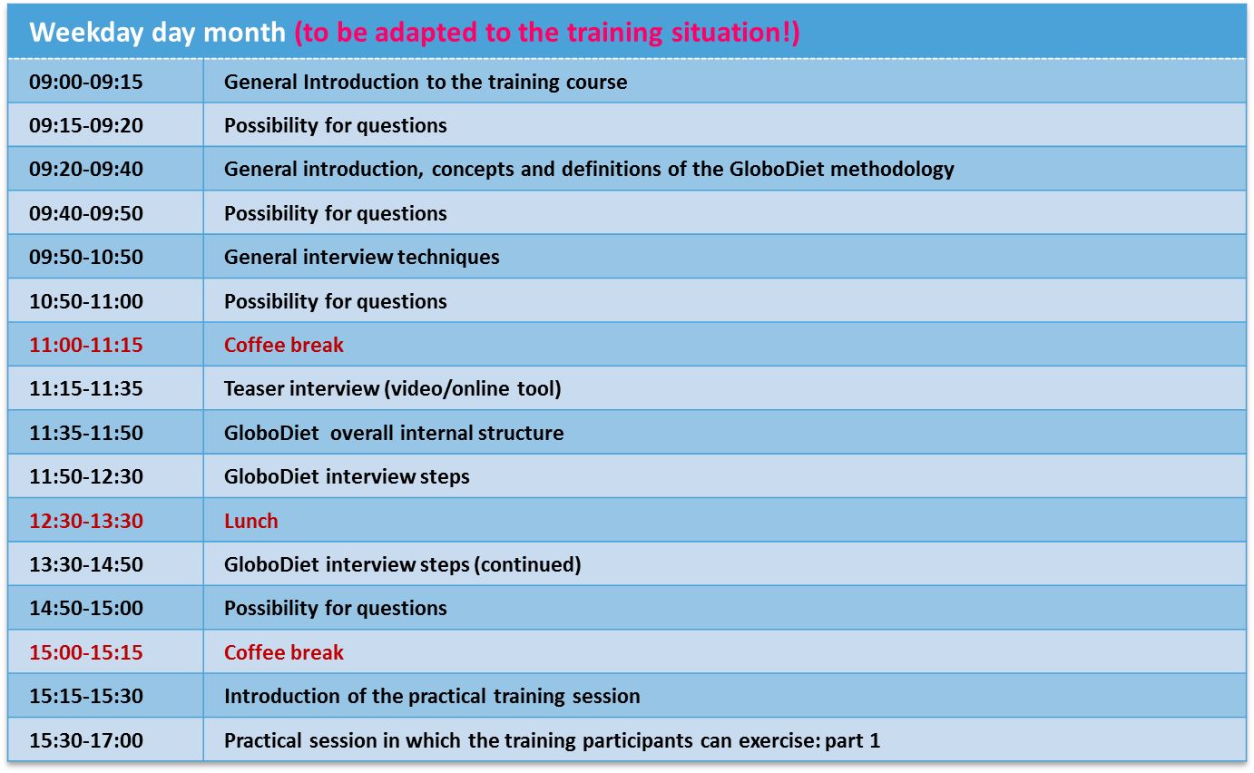
Training Agenda
GloboDiet training: General Introduction
IARC, Lyon - France
Notes:
Agenda of train-the-trainers course needs to be included!

Slide 7
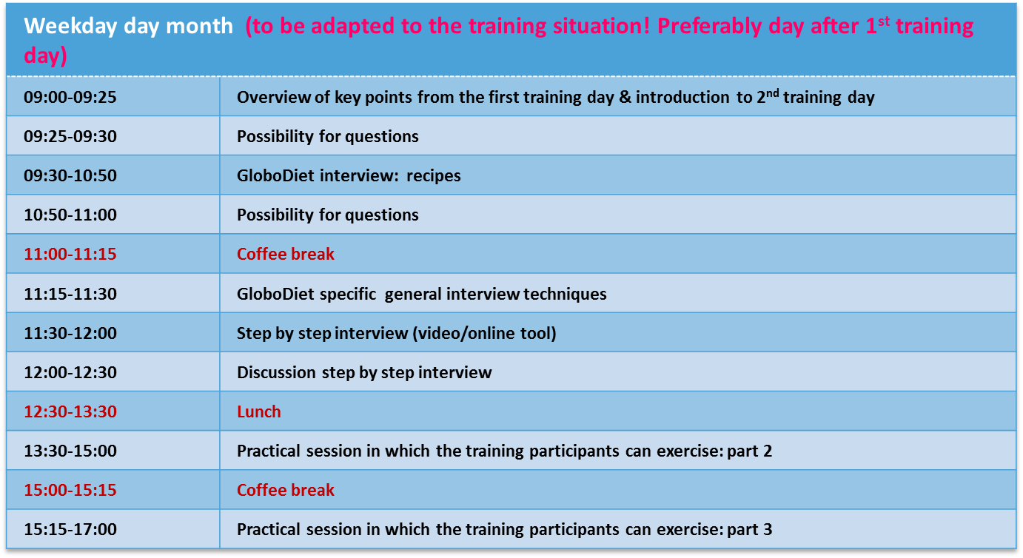
Training Agenda
GloboDiet training: General Introduction
IARC, Lyon - France
Notes:
Agenda of train-the-trainers course needs to be included!

Slide 8
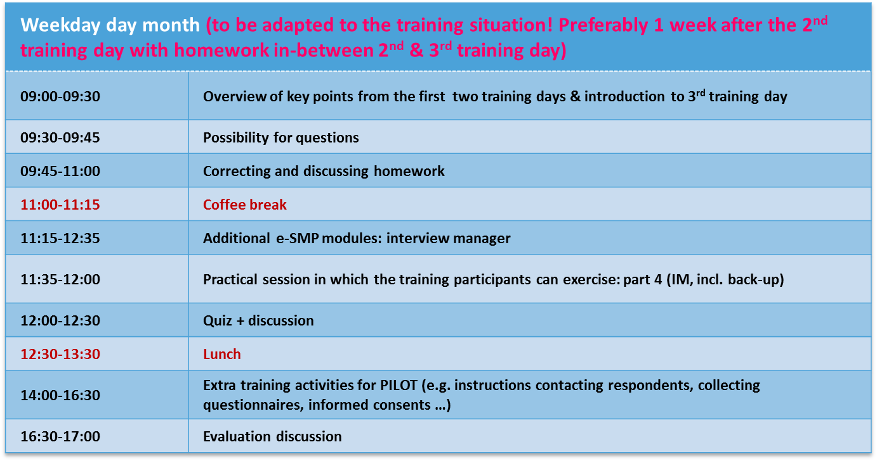
Training Agenda
GloboDiet training: General Introduction
IARC, Lyon - France
Notes:
Agenda of train-the-trainers course needs to be included!

Slide 9
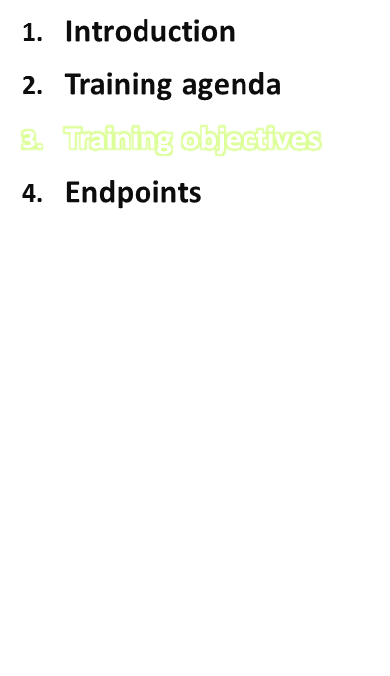
Training objectives:
To train the personnel responsible for training the local/national interviewers who will perform dietary data collection fieldwork using the GloboDiet methodology thus ensuring a standardised collection & management of dietary interview data
To train those who will train the personnel in charge of handling GloboDiet dietary interview data (e.g. exporting, cleaning, etc.)
To provide the people in charge of the local training with practical tips how to organise their local GloboDiet training and how to adapt to local situations while protecting the overall concept of standardisation of the GloboDiet methodology between countries.
GloboDiet training: General Introduction
IARC, Lyon - France

Slide 10
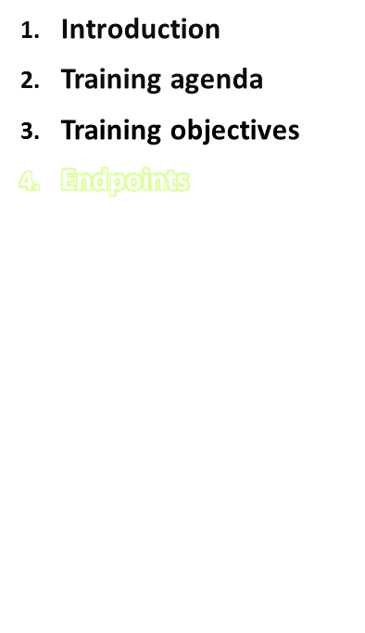
At the end of the course attendees are expected to be able to:
Use the GloboDiet application and the related management and interview tools
Perform data export and handling outside the GloboDiet application
Organise a local GloboDiet training in order to instruct the national (regional) survey interviewers (i.e. dietitians or similar).
GloboDiet training: General Introduction
IARC, Lyon - France
Notes:
Be aware that the interviewers will need their laptop with EPIC-Soft at home to exercises between the different training sessions (see also presentation: Summary & Tips for Planning the Local EPIC-Soft Training)!

